Slide 1
Modelling the power sector in East Asia:
Economic and Environmental impacts
by choices of Power Sources
Soocheol Lee
（Meijo University）
Co-authors
Yuki Ogawa（Kyoto University）
Jean-Francois Mercure
（Cambridge Centre of Climate Change Mitigation Research）
Hector Pollitt
（Cambridge Econometrics）

Slide 2
Research Objective
2. Modeling Tool
3. Scenarios
4. Results
5. Conclusion

Slide 3
Research Objective
Quantitative Analysis of...
・Power Mix
・Environmental Effect (CO2 Emission)
・Economic Effect(GDP etc.)
by Choices of Power Sources
in East Asia (Japan, China, Korea, Taiwan)
ケンブリッジ大学気候変動研究所（４ＣＭＲ）が開発したFTT:Power（Future Technology Transformations for the power sector ）モデルおよびケンブリッジエコノメトリックスのE3MEモデルを、東アジア（日本、中国、韓国、台湾）における電源政策（選択）が、それぞれの環境（CO2）と経済（GDP、雇用など）にどのような影響を与えるのか定量的に分析
原子力発電に制約をかけた場合に、それぞれの環境と
経済、特に再生可能エネルギーのシェアに与える影響分析
石炭火力に制約をかけた場合に、それぞれの環境と経済、
特に再生可能エネルギーのシェアに与える影響分析

Slide 4
Research Objective
Analyzed Energy Policies…
・Regulation on Nuclear Power
・Regulation on Coal-Fired Power
・Regulation on Both above
What effect does transition has to…
・Nuclear waste free
・Less CO2 intensive
the power sector?
ケンブリッジ大学気候変動研究所（４ＣＭＲ）が開発したFTT:Power（Future Technology Transformations for the power sector ）モデルおよびケンブリッジエコノメトリックスのE3MEモデルを、東アジア（日本、中国、韓国、台湾）における電源政策（選択）が、それぞれの環境（CO2）と経済（GDP、雇用など）にどのような影響を与えるのか定量的に分析
原子力発電に制約をかけた場合に、それぞれの環境と
経済、特に再生可能エネルギーのシェアに与える影響分析
石炭火力に制約をかけた場合に、それぞれの環境と経済、
特に再生可能エネルギーのシェアに与える影響分析

Slide 5


2. Modeling Tool

Slide 6
2. Modeling Tool
E3ME-Asia Model
Macro-Econometric Model
developed by Cambridge Econometrics
Reinforced Asian sector by collaboration work with
REEPS(Research group of East Asian Environmental Policy Studies)
in Japan
・Demand driven
・No equilibrium, Non optimization
・Four East Asian regions are in the model
・Based on data from past 40 years and OECD/IEA forecast

Slide 7
E3ME Energy-Environment Linkages
emissions policy
ECONOMY
as in national
accounts
eg industrial emissions of SF6
funding R&D
TECHNOLOGY
specifications &
costs
pollution-
abatement
equipment
prices
and
activity
feedback
low-carbon
processes &
products
energy-saving
equipment etc
ENERGY
as in energy
statistics
ENVIRONMENTAL
EMISSIONS
as in environmental
statistics
fuel use

Slide 8
2. Modeling Tool
FTT: Power
Bottom-up model specifically dealing with power sector
Developed by Cambridge Centre of
Climate Change Mitigation Research, University of Cambridge
・No equilibrium, Non optimization
・24 technologies for power generation

Slide 9
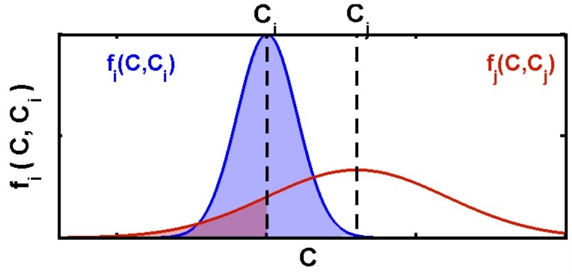

FTT: Power (1)
Probabilistic decision making
between two technologies
$$[F_{ij}]$$
Probabilistic Choice Matrix:
J.-F. Mercure, Energy Policy 48, 799-811 (2012)

Slide 10
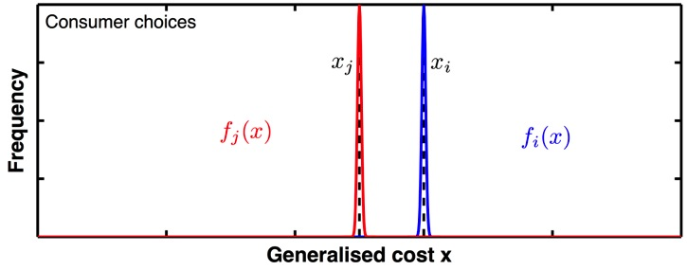
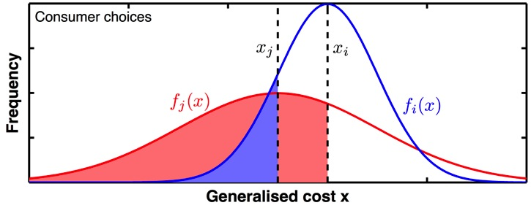
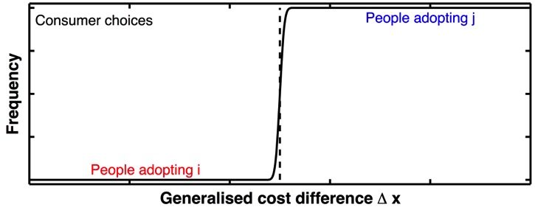
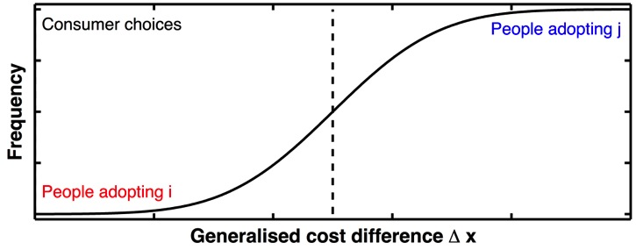
FTT: Power (2)
Choice probability distribution
depends on cost distribution
0
0
※Δx=xi-xj
J.-F. Mercure, Energy Policy 48, 799-811 (2012)
Choice probability represents diversity of investors

Slide 11

FTT: Power (3)
Aggregate technology substitution
Substitutions
Coal
Coal
Coal
CCGT
CCGT
$$[F_{ij}]$$
CCGT
Hydro
Hydro
Hydro
Wind
Wind
Wind
PV
PV
PV
BIGCC
BIGCC
BIGCC
…
…
…
t
t
J.-F. Mercure, Energy Policy 48, 799-811 (2012)

Slide 12
FTT: Power (4)
Technology shares determined by
Aggregating every choices
J.-F. Mercure, Energy Policy 48, 799-811 (2012)
Si : Share of technology i
Aij : Life time of technology i and lead time of technology j
Fij : Probability that technology i would be chosen between i and j
t : time

Slide 13
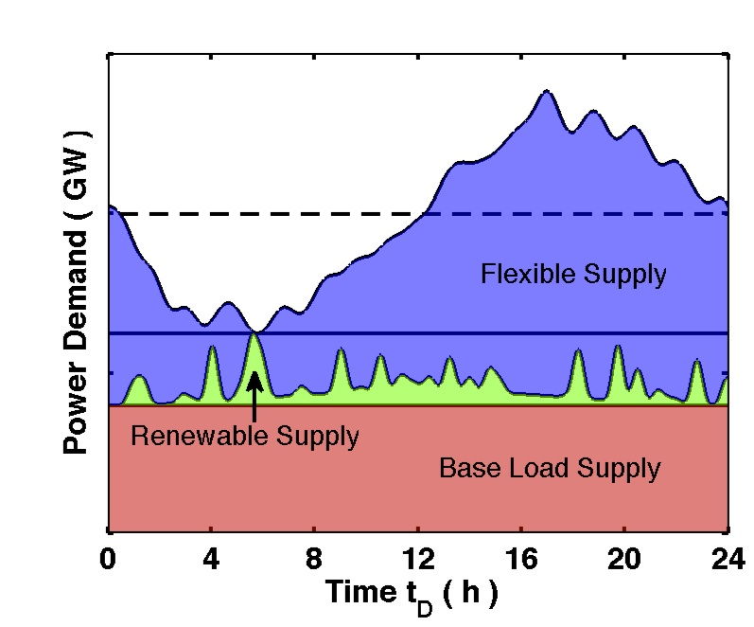
FTT: Power (5)
Capacity share restricted by
technology type
J.-F. Mercure, Energy Policy 48, 799-811 (2012)

Slide 14
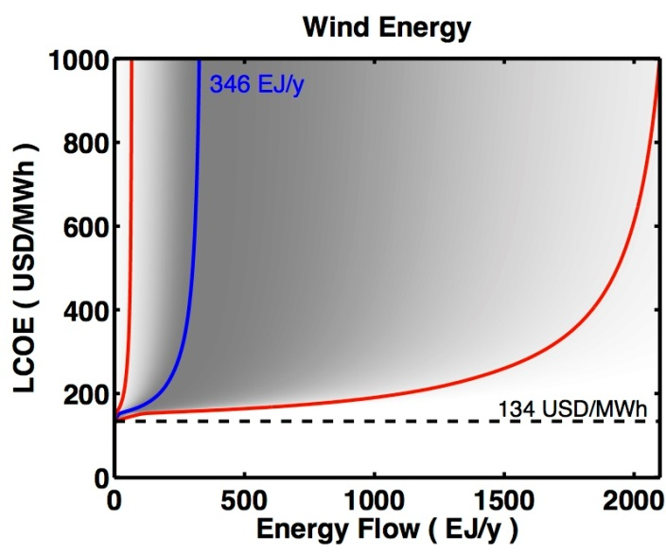
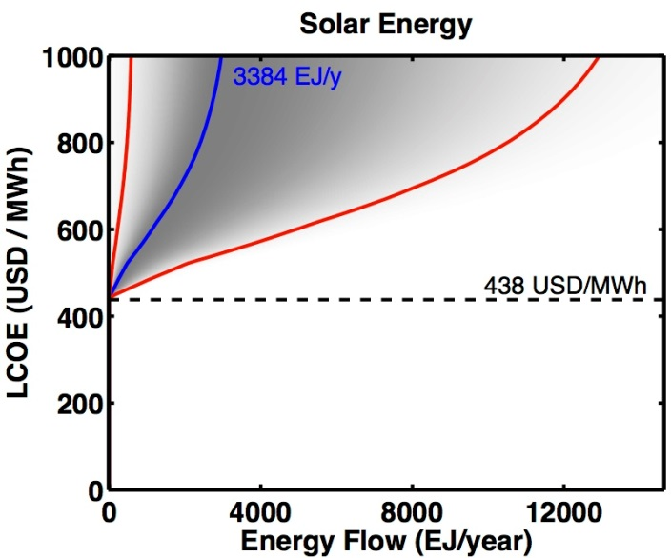
FTT: Power (6)
Cost-Supply Curve
= Natural resource availability
Mercure & Salas, Energy 46, 322-336 (2012)
・Cost increases as the technology diffuses
since less resource being available
・Learning effect from cumulative capacity

Slide 15
FTT: Power (7)
Link between E3ME and FTT
FTT
・Fuel consumption
・Investment in
new power source
・Electricity price
・Electricity demand
・Fuel demand
E3ME
・CO2 emission
・Investment spill over

Slide 16
3. Scenarios
Reference case (Baseline)
Common assumption among all scenarios
to be the reference
Policy scenarios

Slide 17
Common assumption (1)
Support to renewable energy
○Target technology
- represent policy of each country
○Support scheme
- modeled as feed-in tariff
Support policy of each country
China：FIT with bidding
Japan：FIT
Korea：Renewable portfolio standard (RPS)
Taiwan：FIT
support rate < -100%
Generation cost
Electricity
price
Cost seen from investor

Slide 18
Common assumption (2)
Exogenously determined tech.
○Nuclear power
Political investment decision
→Capacity is set according to the national plans
○Oil-fired power
IEA members (JP, KR) won’t build new plants
Taiwan also follows this rule
○Large hydro power
Difficult to add new capacity due to social condition
※FTT: Power determines the share excluding
3 technologies from total electricity demand

Slide 19
Scenario assumptions
Analyzed from 2015 to 2030
Holding all common assumptions
S1: Restriction on nuclear power
CN, KR: No share increase of nuclear after 2015
JP: Zero nuclear after 2015
TW: Nuclear decrease is already in the reference case
S2: Restriction on coal-fired power
No share increase of coal-fired power after 2015
S3: Restriction on both nuclear and coal-fired power

Slide 20
4. Results
Power mix
Environmental and Economic Impacts
Effect of policy harmonization

Slide 21
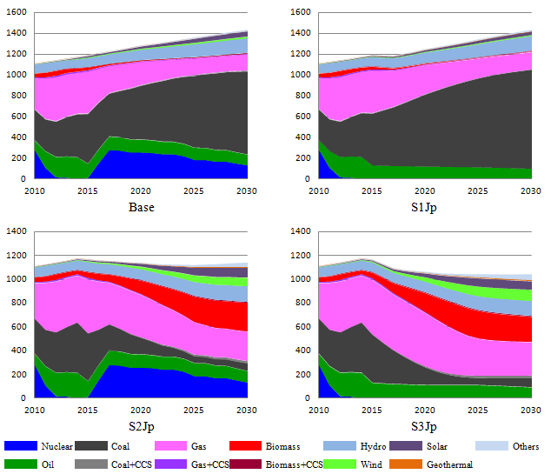
Japan, Generation by technology (TWh)

Slide 22
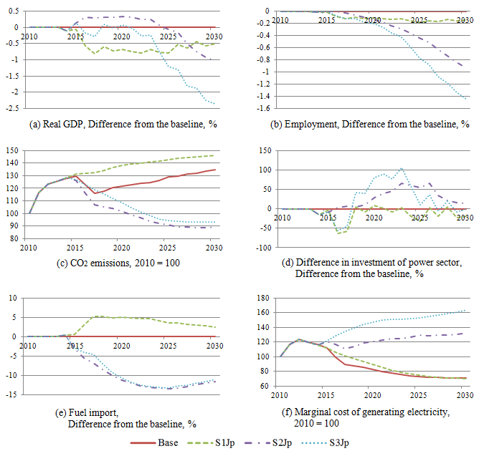
Japan, Environment and Economy

Slide 23
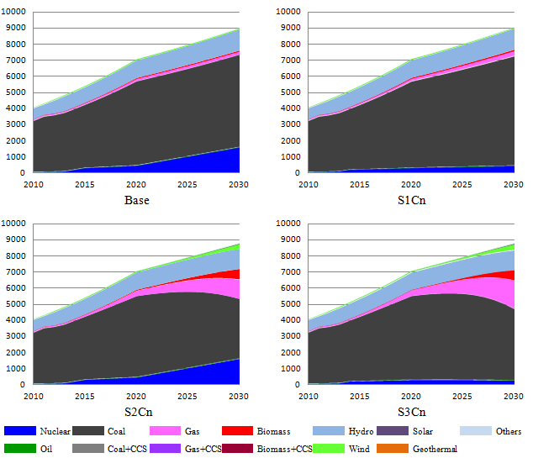
China, Generation by technology (TWh)

Slide 24
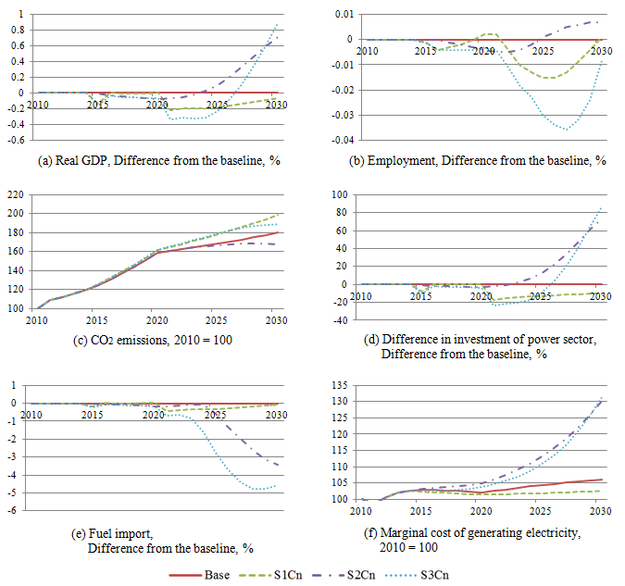
China, Environment and Economy

Slide 25
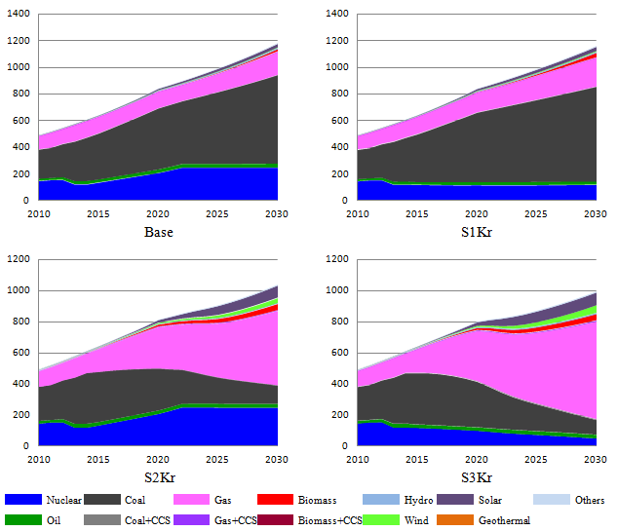
Korea, Generation by technology (TWh)

Slide 26
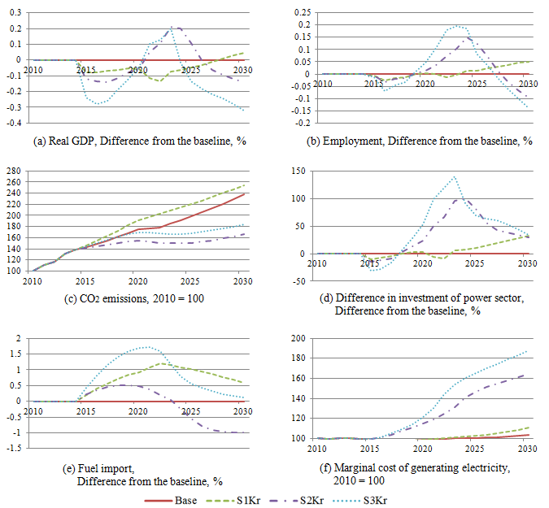
Korea, Environment and Economy

Slide 27
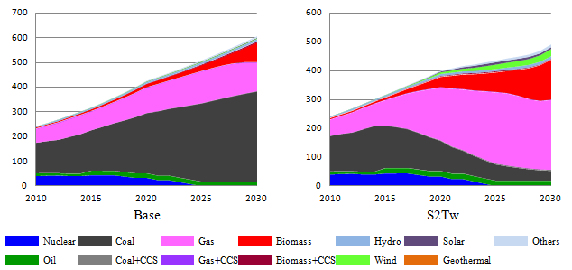
Taiwan, Generation by technology (TWh)

Slide 28
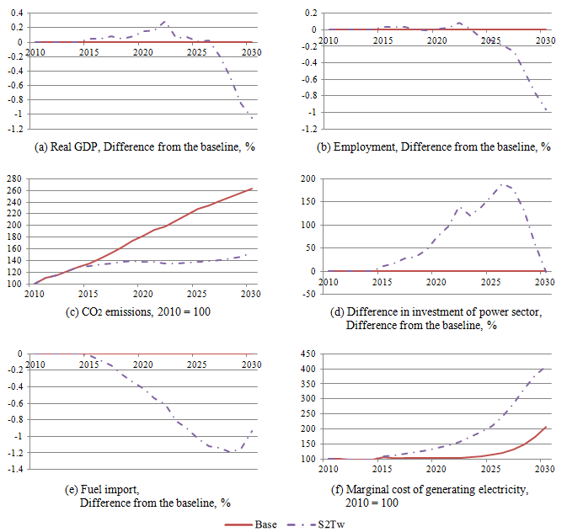
Taiwan, Environment and Economy

Slide 29
Impact comparison between restriction on single country
and harmonized restriction in all coutries
Real GDP in 2030 by country and scenario: dif. from reference case
 | S1 (Nuclear) |  | S2 (Coal-fired) |  | S3 (S1+S2)
 | Single | All | Single | All | Single | All
JP | -0.51 | -0.52 | -1.04 | -1.05 | -2.36 | -2.22
CN | -0.06 | -0.06 | 0.71 | 0.66 | 0.89 | 0.83
KR | 0.05 | 0.03 | -0.14 | -0.11 | -0.32 | -0.33
TW | ー | -0.03 | -1.05 | -0.95 | ー | -0.99
・Economic situation in JP & CN spills to other countries
・Harmonized restriction makes
energy price higher in all countries
→No single country loses its competitiveness

Slide 30
5. Conclusion
Power mix
Environmental and Economic Impacts
Effect of policy harmonization

Slide 31
Power mix
Restriction on nuclear power (S1):
Reduced share is mostly substituted
by conventional power sources
Restriction on coal-fired power (S2):
Share of renewable energy increases significantly
・Both nuclear and coal-fired power are
assumed to be baseload technology
・Restriction on coal-fired power,
which dominates the power sector,
makes space for renewable energy to come in

Slide 32
Environmental and Economic impacts
Large effect on CO2 emissions
(up to 100 % compared to the reference case)
Economic effects are relatively small
(mostly less than ±1% compared to the reference case)
Positive factor: reduced fuel import,
investment in new power sources
Negative factor: high electricity price

Slide 33
Effect of policy harmonization
・Economic situation in JP & CN spills to other countries
・Harmonized restriction makes
energy price higher in all countries
→No single country loses its relative competitiveness
・Diffusion of new technologies in each countries
→learning spill over

Slide 34
Thank you for listening!!

